Slide 1

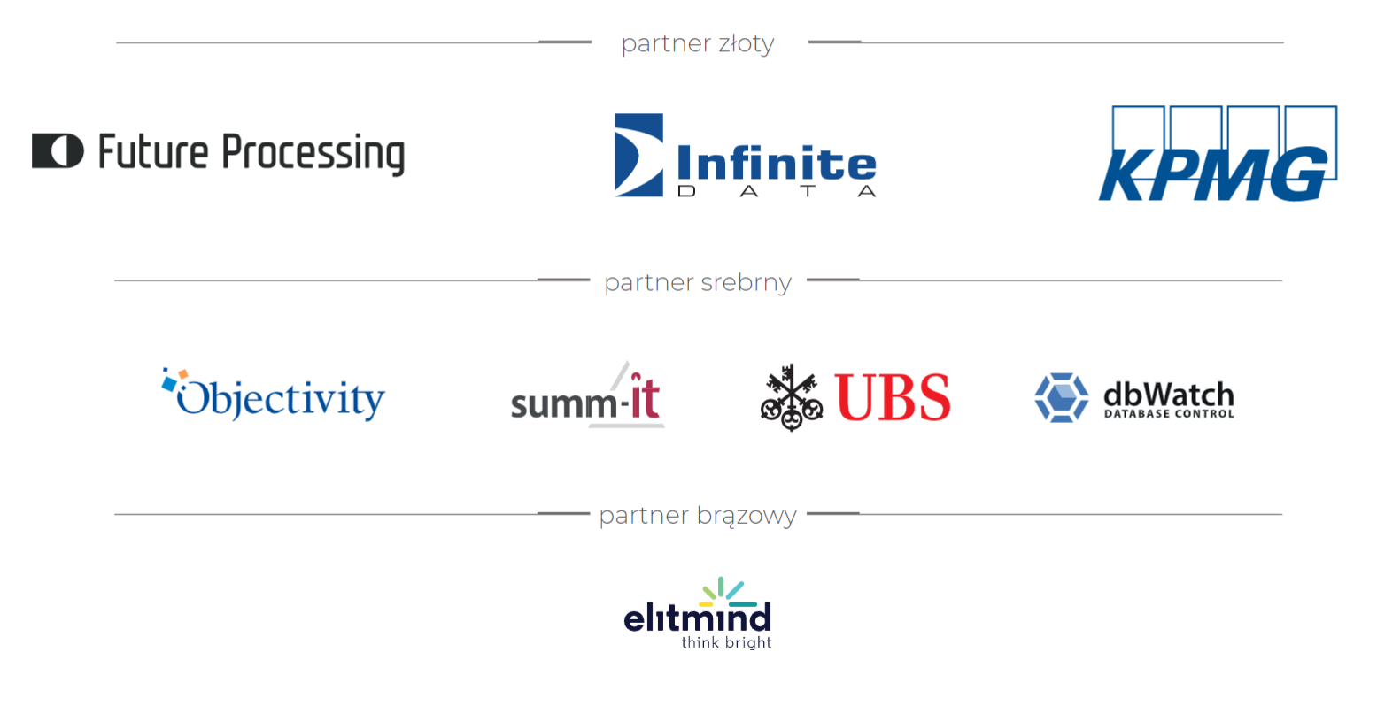

Slide 2

Introduction to Amazon Redshift Cloud Data Warehouse
John Q. Martin CITP

Slide 3


Your Presenter
John Q. Martin (HE | HIM)
Specialist Solutions Architect
Over 15 years experience working with data platform technology on-premises and in cloud based environments.
AWS and Microsoft Certified.
Chartered IT Professional.

Slide 4
AGENDA
Cluster Architecture
Amazon Redshift Storage
Database Design Concepts
Workload Management
Operational Requirements

Slide 5
What is Amazon Redshift?

Slide 6
Use Cases
Data Warehousing
Enterprise Customers
Deliver the same analytics capabilities
Analytics Applications
SaaS Applications
Embedded Analytics
Big Data Analytics
Machine Learning
Data Lake Integration

Slide 7














Amazon Redshift Architecture
Amazon RDS
Amazon
Redshift
Integrations
Federated Query
Amazon Aurora
Data Lake
Auto-Scaling
Copy | Unload | Query
Redshift Managed Storage
Data Sharing

Slide 8
Amazon Redshift Architecture

Slide 9
Amazon Redshift Architecture
 | vCPU | Memory | RMS per-node | Slices
RA3.xlarge | 4 | 32 | 32 TB | 2
RA3.4xlarge | 12 | 96 | 128 TB | 4
RA3.16xlarge | 48 | 384 | 128 TB | 16
 | vCPU | Memory | Storage per-node | Slices
DC2.xlarge | 2 | 15 | 160 GB NVMe-SSD | 2
DC2.8xlarge | 32 | 244 | 2.56 TB NVMe-SSD | 16

Slide 10
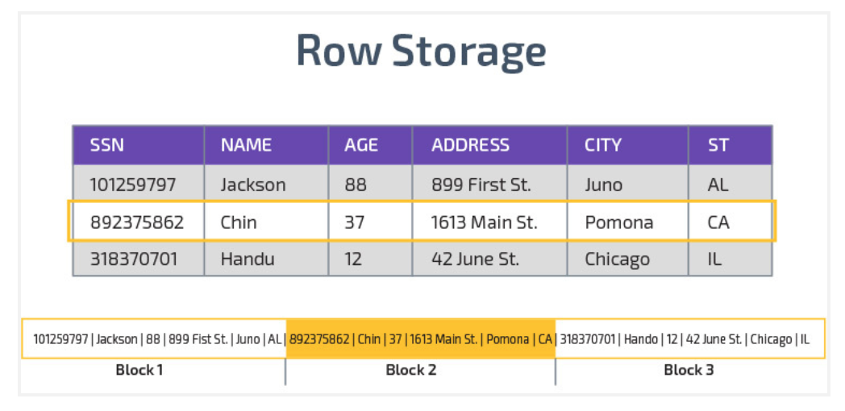
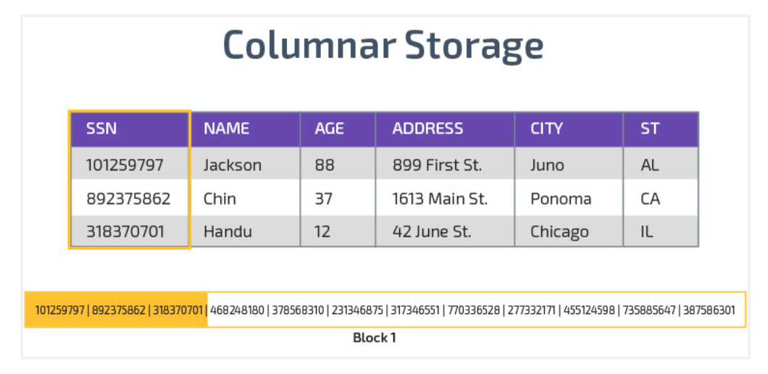
Amazon Redshift Storage
Row storage (e.g. MySQL): all row fields are stored together on disk (typically in a sequential file)
Accessing a column (example: scanning SSN of all residents) with row storage:
Scan every column in every row of the table
Resultant unnecessary I/O and caching overhead
Column storage (e.g. Amazon Redshift): each table column is stored separately on disk (typically in a separate file or set of files)
Accessing column (example: scanning SSN of all residents) with columnar storage:
Only scan blocks for relevant column(s)
Significant less I/O

Slide 11
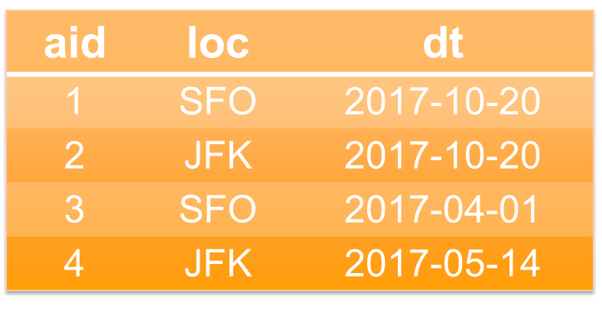
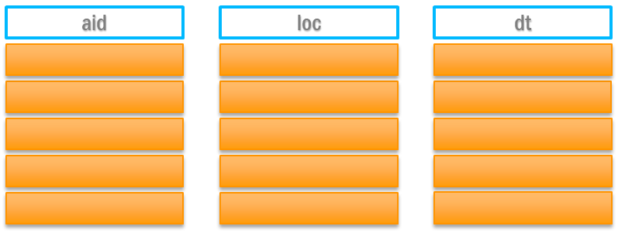
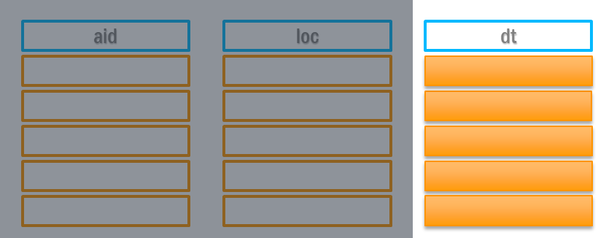
Amazon Redshift Storage
Given the following table definition and data for the deep_dive table, how will a simple SQL query behave in a row-based data store, and then in a column-based store?
CREATE TABLE deep_dive (
aid INT --airport_id
,loc CHAR(3) --location
,dt DATE --date
);
SELECT min(dt) FROM deep_dive;
Row-based storage behavior
Need to read everything
Unnecessary I/O
Column-based storage behavior
Only scan blocks for relevant column
Significantly less I/O

Slide 12
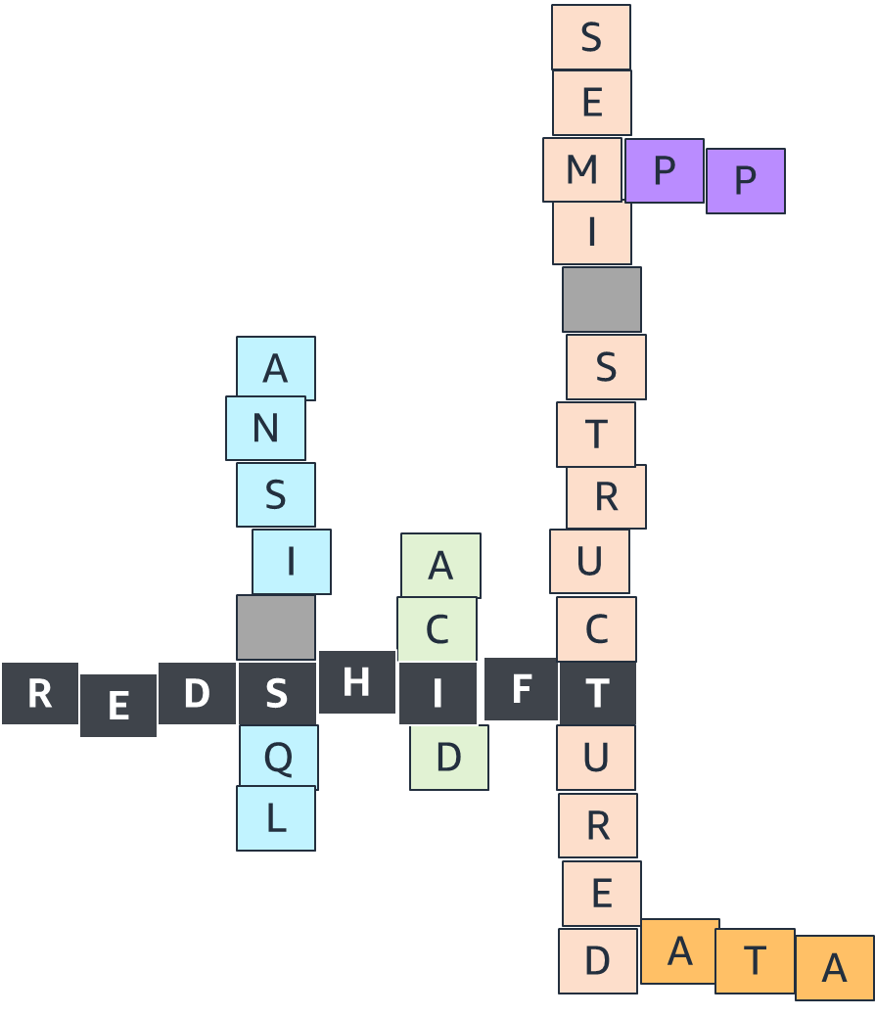
Amazon Redshift Database Design
Redshift is an ACID and ANSI SQL Compliant Data Warehouse
Parallelism, efficient columnar storage, and efficient I/O in Redshift are significantly impacted by choice of table distribution styles, data compression, and sort keys
Leverages sort keys, distribution, parallelism, and efficient data storage to achieve fast performance
Redshift creates one database by default
Use Schema quotas to apply governance for self service

Slide 13
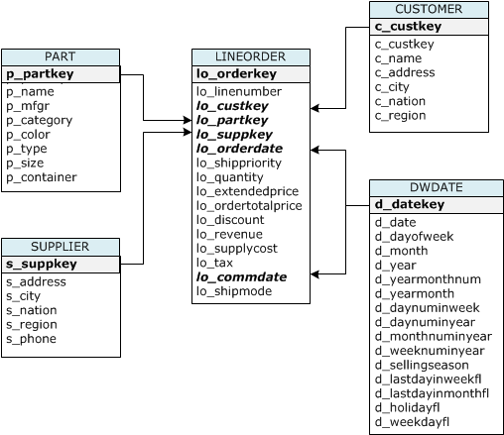
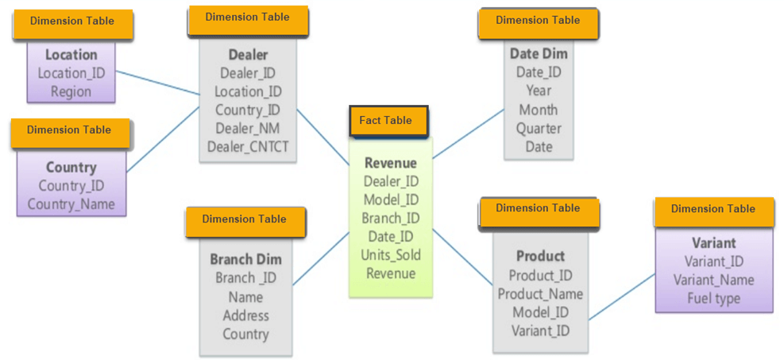
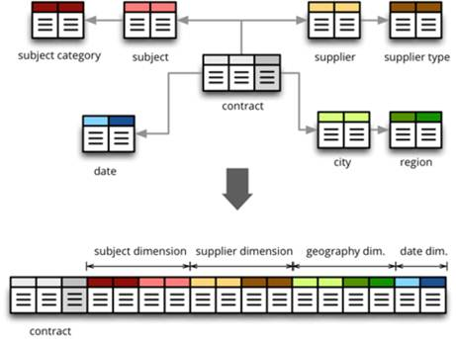
Amazon Redshift Database Design
Highly Denormalised
Snowflake Schema
Star Schema

Slide 14
Amazon Redshift Database Design
Data Distribution
KEY
A column value is hashed (usually a popular join column), and the same hash value is placed on the same slice
ALL
Full table data is placed on each compute node’s first slice; recommended for relatively static tables < 3m rows
EVEN
Data is evenly distributed across all slices using a round-robin distribution
AUTO
Default (preferred) option; Redshift determines the best distribution style based on observed query interactions with tables, distribution style can change dynamically
Distribution style is a table property that dictates how that table’s data is distributed on internal storage.
Data Distribution Goals
Distribute data evenly for parallel processing
Ensure each node has the same amount of data
Minimize data movement during query processing

Slide 15

Amazon Redshift Database Design
The deep_dive table has three columns; let’s insert new rows to see the distribution styles in action for a two-node Redshift cluster, each node having two slices
INSERT INTO deep_dive VALUES
(1, 'SFO', '2016-09-01'),
(2, 'JFK', '2016-09-14'),
(3, 'SFO', '2017-04-01'),
(4, 'JFK', '2017-05-14');
CREATE TABLE deep_dive (
aid INT --airport_id
,loc CHAR(3) --location
,dt DATE --date
) DISTSTYLE [EVEN | KEY DISTKEY (loc) | ALL];
TIP: When using the KEY dist style, select a distribution key column that has high cardinality to help avoid row skew across slices
EVEN
( round-robin distribution )
KEY
( hashing-based distribution )
ALL
( full table copy on each node )
Node 1
Node 2
Node 1
Node 2
Node 1
Node 2
Slice 0 Slice 1
Slice 2 Slice 3
Slice 0 Slice 1
Slice 2 Slice 3
Slice 0 Slice 1
Slice 2 Slice 3
SFO
JFK
# Rows: 1
# Rows: 1
# Rows: 1
# Rows: 1
# Rows: 1
# Rows: 2
# Rows: 1
# Rows: 1
# Rows: 2
# Rows: 3
# Rows: 1
# Rows: 4
# Rows: 2
# Rows: 2
# Rows: 1
# Rows: 2
# Rows: 3
# Rows: 4

Slide 16
Amazon Redshift Database Design
Data Sorting
Redshift uses sort keys to physically order data on disk
Sort keys combined function like an index in Redshift for a given set of columns and enable range-restricted scans to reduce I/O
AUTO Sort Key- Amazon Redshift chooses the sort key using automatic table optimization
Compound Sort Key
Sort key is composed of one or more columns
Should be in order of lowest to highest cardinality

Slide 17

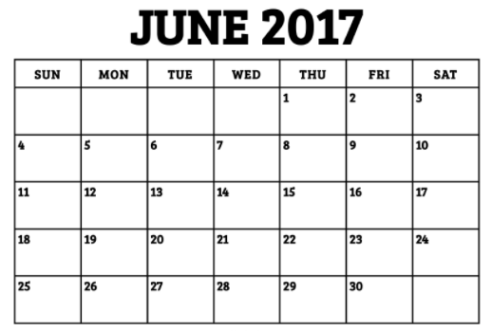
Amazon Redshift Database Design
SELECT count(*)
FROM deep_dive
WHERE dt = '06-09-2017';
Unsorted table
Sorted by date
MIN: 01-JUNE-2017
MAX: 20-JUNE-2017
MIN: 01-JUNE-2017
MAX: 06-JUNE-2017
MIN: 08-JUNE-2017
MAX: 30-JUNE-2017
MIN: 07-JUNE-2017
MAX: 12-JUNE-2017
MIN: 12-JUNE-2017
MAX: 20-JUNE-2017
MIN: 13-JUNE-2017
MAX: 21-JUNE-2017
MIN: 02-JUNE-2017
MAX: 25-JUNE-2017
MIN: 21-JUNE-2017
MAX: 30-JUNE-2017

Slide 18
Amazon Redshift Workload Management
Workload Management
Enabled by default
Optimizes resources for maximum query throughput and consistent performance
Prevents expensive queries from consuming system resources
Create up to eight query queues
Query Monitoring Rules
Extends upon Workload Management (WLM)
Helps handle runaway queries
Create up to 25 rules across all queues
Log, Abort, or Hop queries
Automatic Query Re-write
Leverages Materialized Views (MV) to optimize queries
User requires SELECT privilege on the MV to use capability
Preview – Auto-MV will create and remove MVs based on workload

Slide 19
Amazon Redshift Operations
Table Statistics
Table and column statistics used by Query Plan Optimizer
Number of rows/bytes and discrete values in each column, skew of values
Help determine optimal order of filters and joins
Auto-Analyze runs as background task.
Table Management
Need to reclaim space after update and delete activity
Re-sort table data to optimize query IO and remove fragmentation
Auto-vacuum runs as a background task
Monitoring
Review Redshift Advisor in the console
Use Amazon Cloud Watch to create multi-service dashboards to view overall performance
Managed Grafana dashboard for in-depth cluster monitoring

Slide 20
Amazon Redshift HA/DR
Auto-Snapshots
Snapshots taken every 8 hours or 5GB of data change, whichever is first
Stored in Amazon S3
Can be replicated to another Amazon region
Retention between 1 and 35 days
Manual Snapshots
Can be retained forever, good for long-term retention if needed
Can be replicated to another Amazon region
Will incur additional storage costs compared to automatic snapshots
Multi-AZ Resilience
Separation of compute and storage allows for AZ relocation within a region
Manually move cluster between AZs if desired
Cluster endpoint remains consistent so no need to modify connectivity layer

Slide 21
Demo

Slide 22
Summary
Amazon Redshift is a managed cloud data warehouse service providing flexibility and scalability to run modern analytics workloads.
Integration with external data sources such as OLTP systems, data lakes, and Machine Learning (ML)
Massively Parallel Processing (MPP) requires an understanding about distributing data as part of the data model.
Workload Management capabilities built-in but also highly configurable.
Automated tuning for distribution, sorting, and query re-write to aid performance

